Slide 1
Lecture 14: Pointer – Part I
Class page: https://github.com/tsung-wei-huang/cs1410-40
Dr. Tsung-Wei Huang
Department of Electrical and Computer Engineering
University of Utah, Salt Lake City, UT
Notes:
Morning everyone
Today we are looking into control flow in C++.

Slide 2
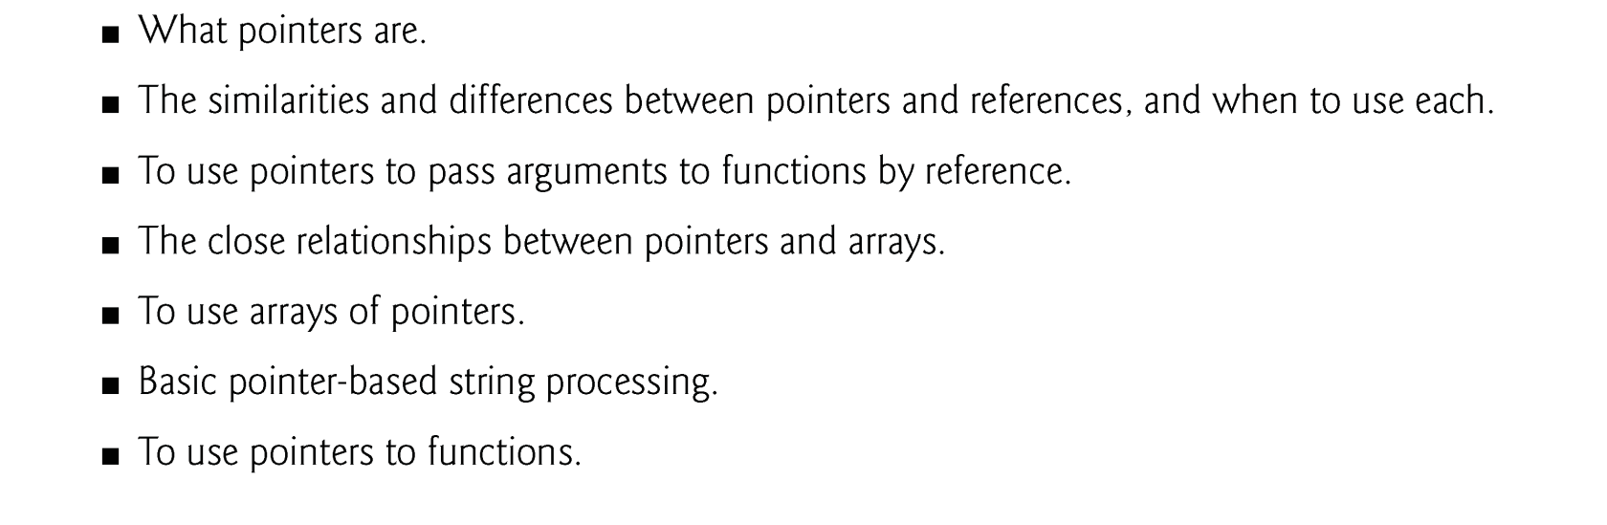
Learning Objective

Slide 3
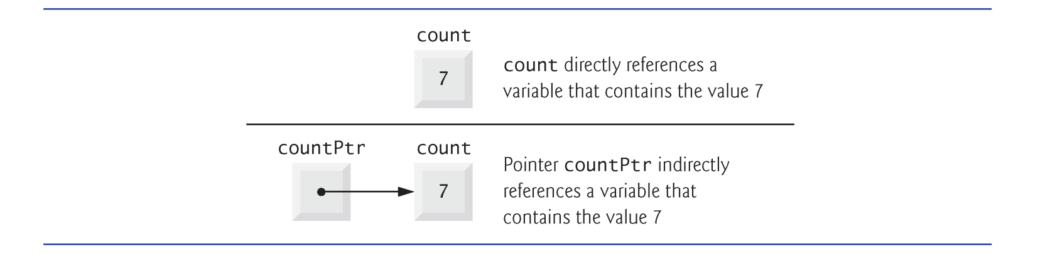
Introduction
A pointer contains the memory address of a variable.
The variable name directly references a value, and a pointer indirectly references a value.
Referencing a value through a pointer is called indirection.

Slide 4
Declaring a Pointer
The declaration
int *countPtr, count;
declares the variable countPtr to be of type int * (i.e., a pointer to an int value)
Read as “countPtr is a pointer to int.”
Variable count in the preceding declaration is declared to be an int, not a pointer to an int.
Each variable being declared as a pointer must be preceded by an asterisk (*).
When * appears in a declaration, it isn’t an operator; rather, it indicates that the variable being declared is a pointer.
Pointers can be declared to point to objects of any data type.

Slide 5
Value of a Pointer
Pointers should be initialized either when they’re declared or in an assignment.
A pointer may be initialized to 0, NULL or an address of the corresponding type.
A pointer with the value 0 or NULL points to nothing and is known as a null pointer.
The value 0 is the only integer value that can be assigned directly to a pointer variable.

Slide 6
Pointer Operator
The address operator (&) is a unary operator that obtains the memory address of its operand.
Cannot be applied to constants or to expressions that do not result in references
Assuming the declarations
int y = 5; // declare variable y int *yPtr; // declare pointer variable yPtr
the following statement assigns the address of the variable y to pointer variable yPtr.
yPtr = &y; // assign address of y to yPtr

Slide 7
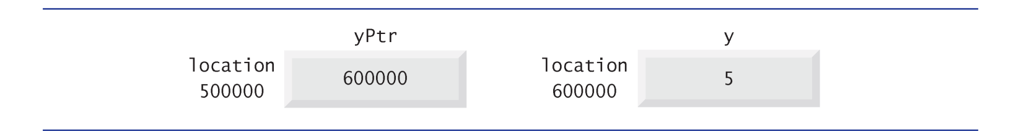
Pointer Operator (cont’d)
Assume the integer variable y stored at memory location 600000 and pointer variable yPtr stored at memory location 500000.
The * operator, commonly referred to as the indirection operator or dereferencing operator, returns a synonym for the object to which its pointer operand points.
Called dereferencing a pointer
yPtr = 600000; *yPtr = 5;

Slide 8
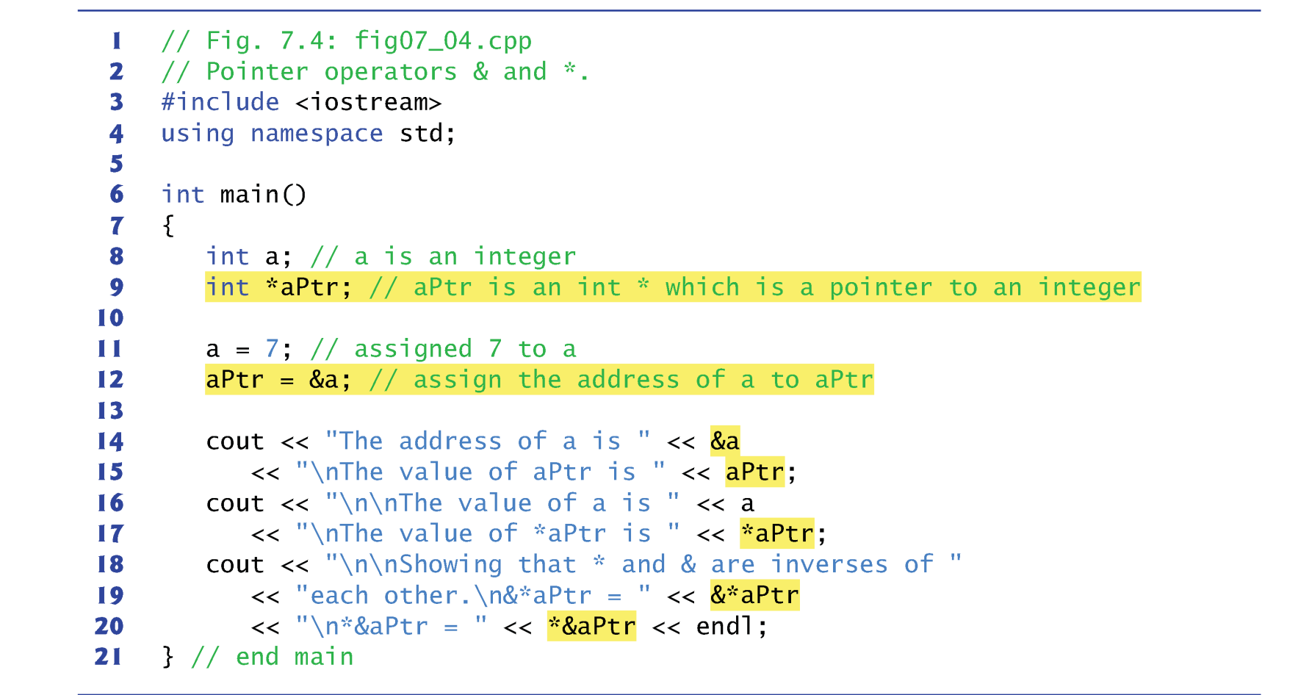
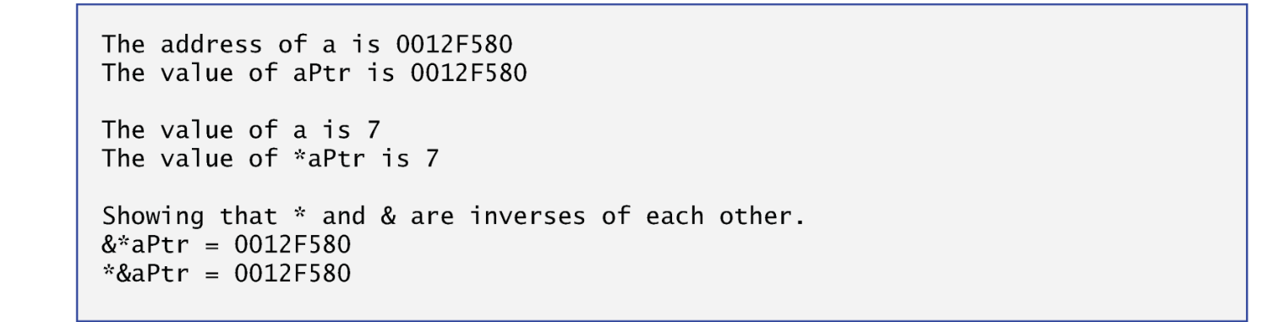
Example
The & and * operators are inverses of one another.

Slide 9
Pass by Pointer (address)
There are three ways in C++ to pass arguments to a function—pass-by-value, pass-by-reference with reference arguments and pass-by-reference with pointer arguments.
We explain pass-by-reference with pointer arguments (pass by pointer)
Pointers, like references, can be used to modify the variables in the caller or to pass pointers to large data objects to avoid the overhead of being passed by value.
In C++, you can use pointers and the indirection operator (*) to accomplish pass-by-reference.

Slide 10
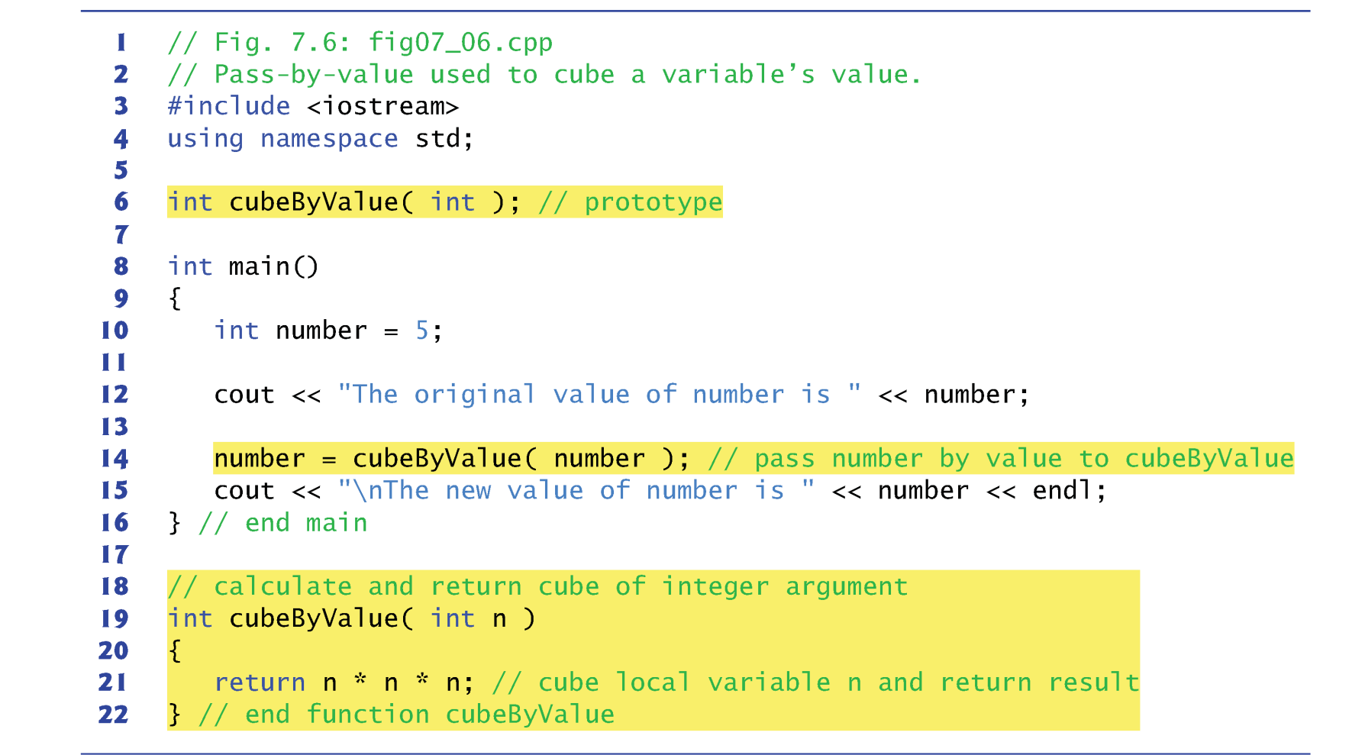
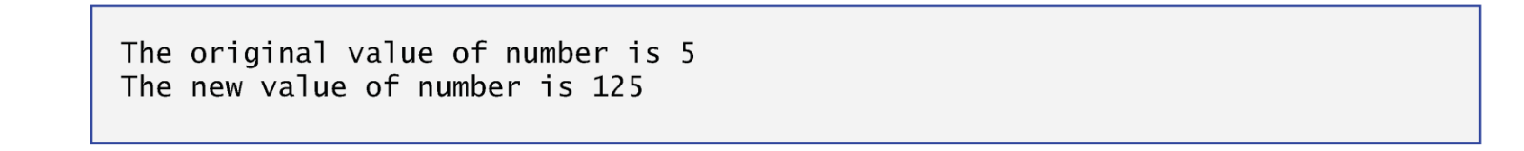
Recap: Call By Value

Slide 11
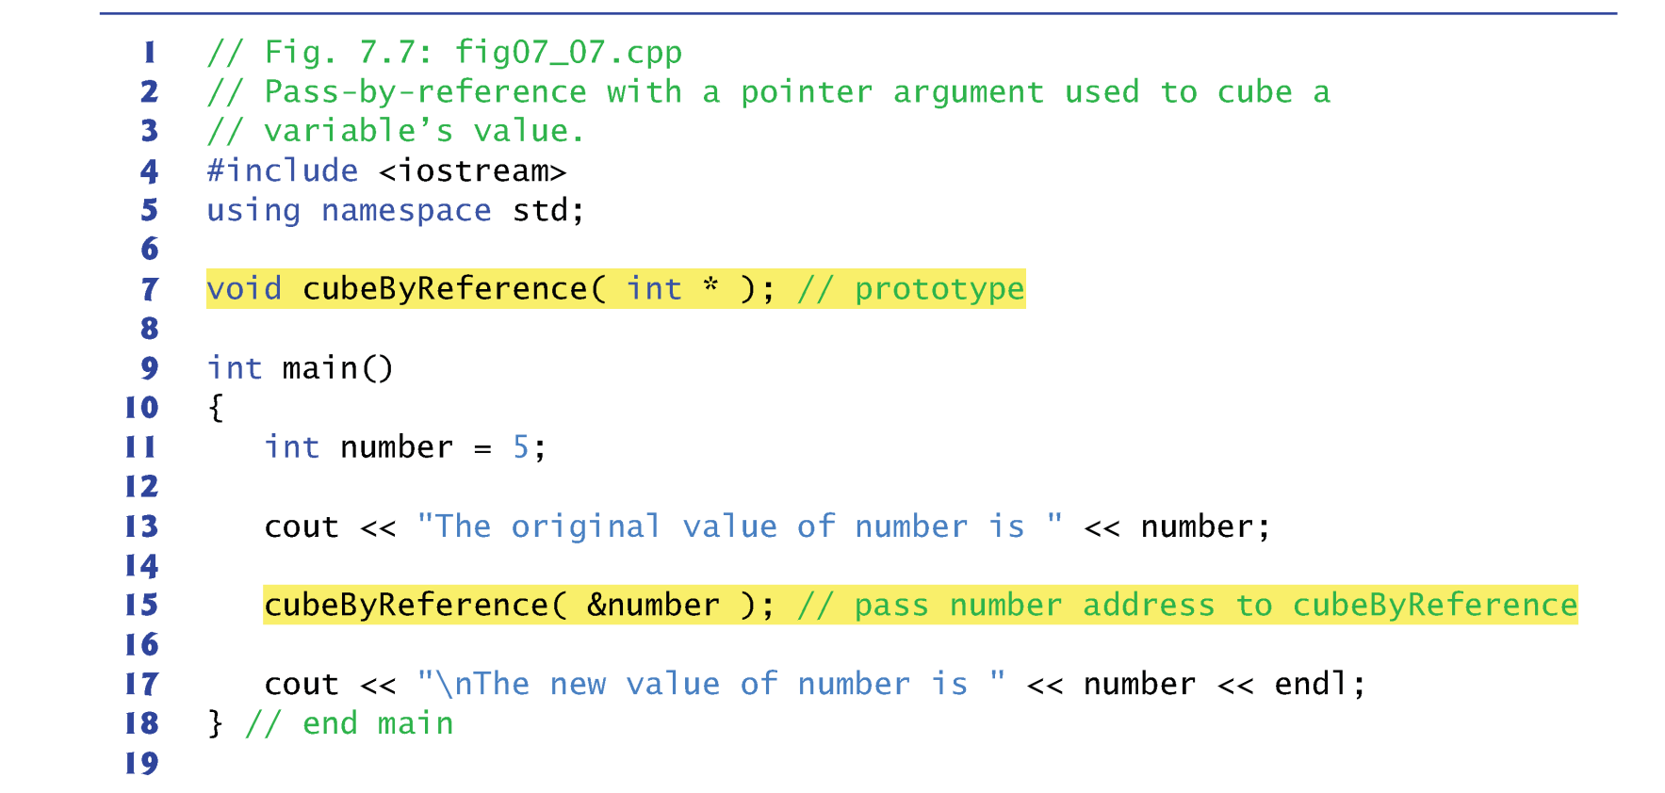
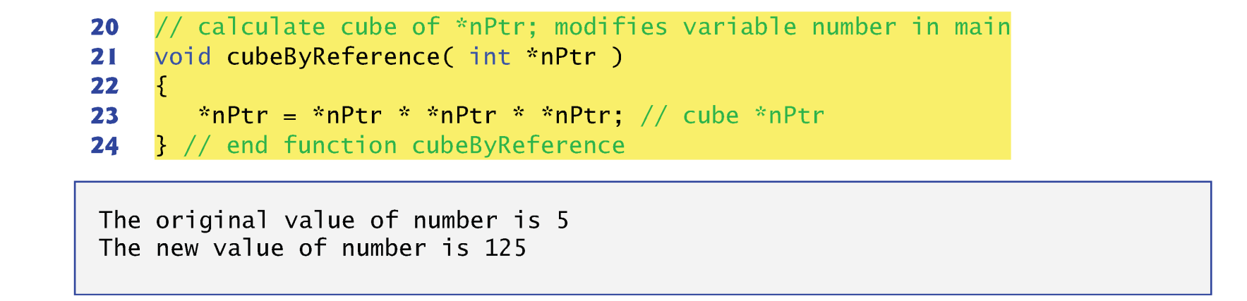
How to do it with Call by Pointer?

Slide 12
Using const with Pointer
A nonconstant pointer to nonconstant data
ex: int *myPtr = &x;
Both the address and the data can be changed
A nonconstant pointer to constant data (Fig. 7.10)
ex: const int *myPtr = &x;
Modifiable pointer to a const int (data are not modifiable)
A constant pointer to nonconstant data (Fig. 7.11)
ex: int *const myPtr = &x;
Constant pointer to an int (data can be changed, but the address cannot)
A constant pointer to constant data (Fig. 7.12)
ex: const int *const Ptr = &x;
Both the address and the data are not modifiable

Slide 13
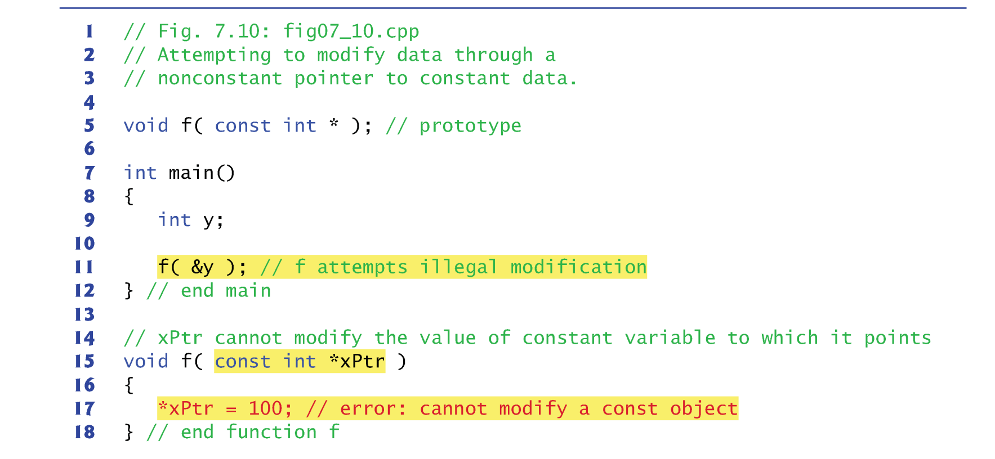
Example of const pointer

Slide 14
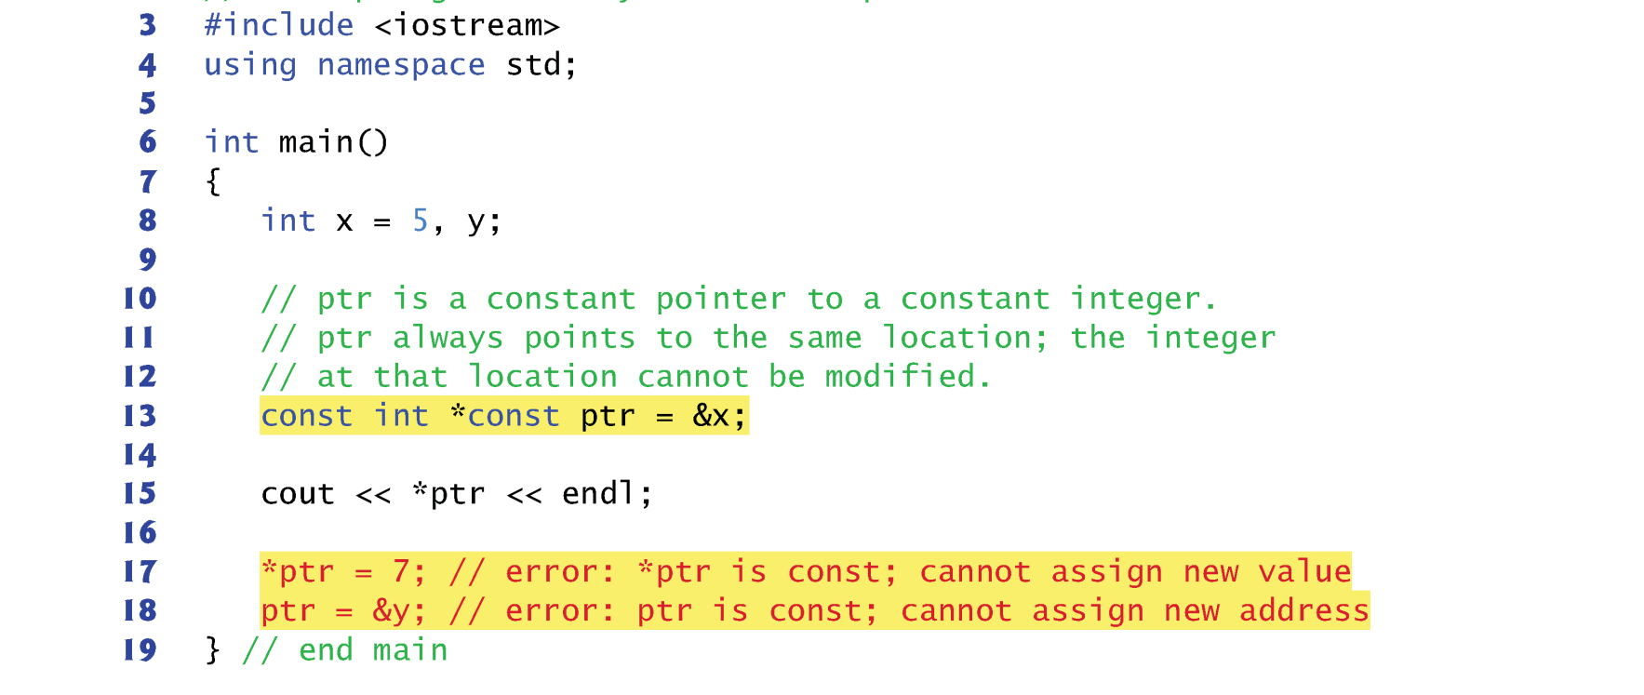
Example of const pointer

Slide 15
Summary
Pointer
Call by value
Call by reference
Call by address (pointer)

